Slide 1
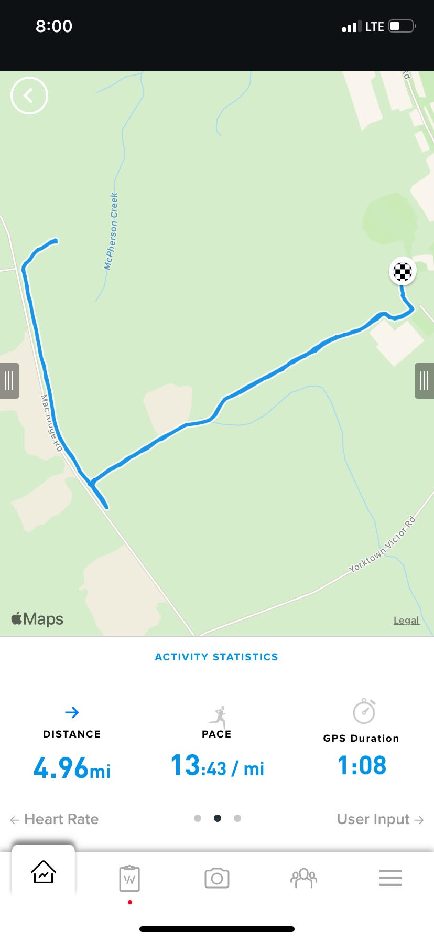
9/11 Memorial “Triple-R Challenge”
DTG: 110846SEP21
N
Ruck turnaround point
MISSION
U.S. Army JAG Corps attorneys and paralegals from Fort Bragg’s tenant units will undertake the “Triple-R Challenge” to memorialize and honor the JAG Corps members lost in combat over the course of the twenty-year Global War on Terror.
INTENT
PURPOSE:
Conduct a 4-mile run, rope climb, and 10-mile ruck march with 35 lbs. within 3.5 hours
END STATE:
Increased camaraderie, esprit de corps, team cohesion, and physical fitness
OSJA
Run turnaround point
CONCEPT OF THE OPERATION
Phase I : RUN – Conduct 4-mile run at a pace of 9 min/mile or faster in APFUs.
Phase II : ROPE – Conduct rope climb on 25’ rope in ACUs (boots).
Phase III : RUCK – Conduct 10-mile ruck march with 35 lbs. at a pace of 15 min/mile or faster in ACUs.
WEATHER PLAN:
Forecast: 75 degrees F, partly sunny. In case of inclement weather, on-the-spot adjustments will be made.
RUN ROUTE: 2-mile out and back on Area J with water and turnaround sign. Start at Riz Epps Parking lot, run past AA Mile Rope, Turn left, then turn right at dirt trail and proceed straight.
RUCK ROUTE: Similar 2.5-mile out and back on Area J with water and turnaround sign. Start at Rope.
PARTICIPANTS:
MAJ Chris Monti (Pacer), CPT Chris Scribner (Proctor), CPT Noah Stochl, CPT Matthew Doyle, SGT Ed Isip, CPT Nelson Robles, CPT Jessica Ditmore, CPT Jonathan Winter
TIMELINE
9 SEP 2021
1600 Event/Safety Brief to SJA/SGM
11 SEP 2021
0830 Warm-up at Ritz-Epps Entrance
0846 Commence 4-mile run
0926 Change into OCPs for rope climb
0945 Commence 10-mile ruck march
1215 Issue coins to event finishers 1230 Commemoration & Comments
1330 Finishers’ Luncheon
COORDINATING INSTRUCTIONS
UNIFORM:
Army Physical Fitness Uniform with sneakers. GPS watch optional.
Army Combat Uniform with boots, patrol cap, camelbak, tinted eye pro, ID card, ID tags, cell phone.
EQUIPMENT:
Ruck sack with 35 lbs.
Digital hanging scale.
Water bottles, gatorades, snacks, ice sheet, emergency whistle, First Aid kit.
SIGNAL
POC: CPT Chris Scribner – (917) 623-0249
APOC: MAJ Chris Monti – (443) 570-7106

